Slide 1
Directions for Constructing Population Pyramids in Microsoft Excel go to: www.prb.org Population Pyramids in Excel

Slide 2
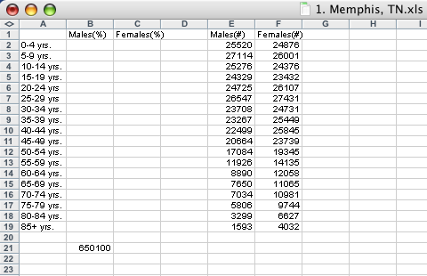
Open up a Microsoft Excel Workbook
and fill in the following…
Type in the statistics from the
Census Bureau
for Males and Females
Type in the
total population

Slide 3
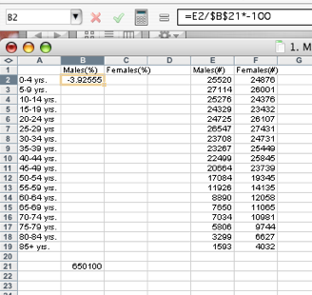
Click in B2 and type in the formula
Move the mouse to the bottom right corner of B2 and when the + appears drag the box down to B19
***The statistics for Males will all be negative numbers.

Slide 4
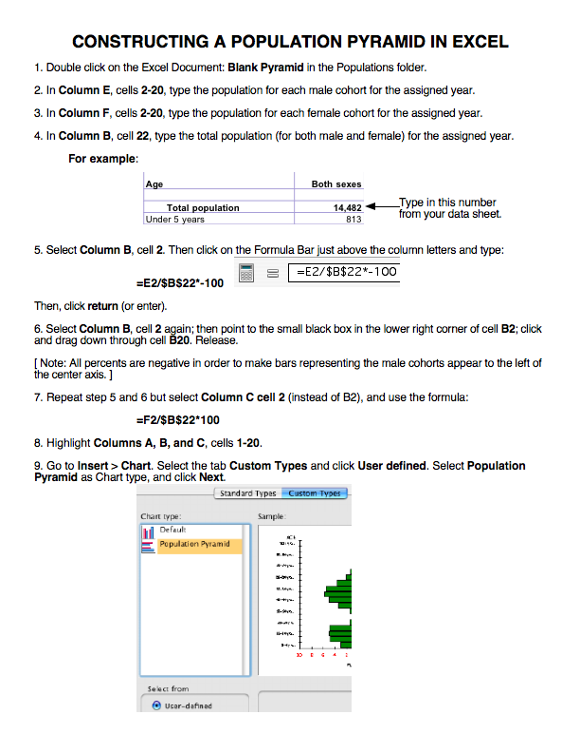

Slide 5
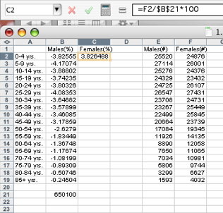
Click in C2 and type in the formula
Move the mouse to the bottom right corner of C2 and when the + appears drag the box down to C19

Slide 6
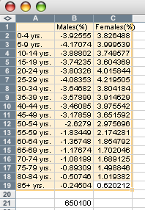
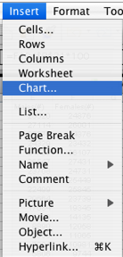
Highlight
Go to Insert and select “Chart...”

Slide 7
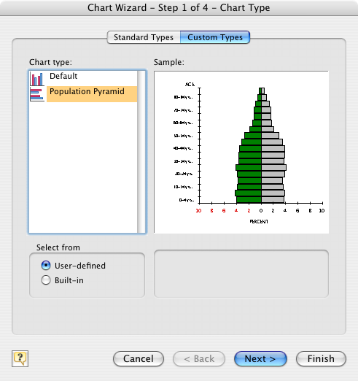
Click on:
“Custom Types” “User-defined”
“Population Pyramid”
“Finish”

Slide 8
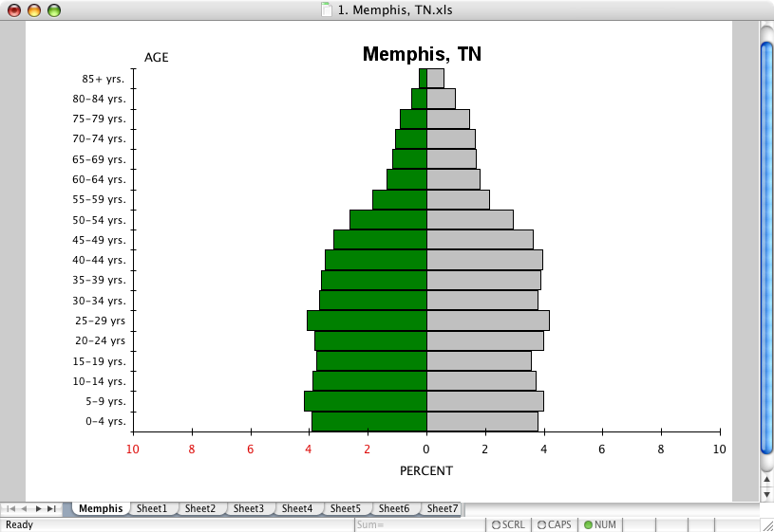
Type in the location for the population pyramid.

